Slide 1
April 2021
IMI External Quality Assurance Centre Support & Guidance Update

Slide 2
Agenda
Vocational Contingency Regulatory Framework (VCRF) overview
Confirmation of VCRF Qualification Categories:
Category A – Adaptations
Category B1 – KS4 subject toTeacher Assessed Grades (TAGs)
Category B2 – (also subject to TAGs where appropriate)
In-flight learners
IQA requirements
Process / timeline

Slide 3
Vocational Contingency Regulatory Framework
(VCRF)

Slide 4
Vocational Contingency Regulatory Framework - 2021
(England, NI and Wales)
To enable Awarding Organisations to be sufficiently flexible to support as many learners as possible to complete assessments, whilst still retaining the integrity of their qualifications, Ofqual are putting in place the Vocational Contingency Regulatory Framework (VCRF).
This framework will enable us to determine the most appropriate approach to awarding based on the qualifications design and delivery.
To enable Awarding Organisations to be sufficiently flexible to support as many learners as possible to complete assessments; whilst still retaining the integrity of their qualifications, Ofqual have put in place the Vocational Contingency Regulatory Framework (VCRF)
This framework will enable us to determine the most appropriate approach to awarding - based on the qualifications design and delivery.

Slide 5
Vocational Contingency Regulatory Framework - 2021
(England, NI and Wales)
Category A
Where qualifications are used to demonstrate occupational or professional competency, proficiency or to gain a licence to practise are necessary, assessments for these qualifications should continue when this is possible, subject to Public Health guidance.
Category B
Alternative arrangements to exams for those VTQs and other general qualifications most like GCSEs, AS and A levels. Many of these were subject to calculated results last summer, and it is likely that some form of Teacher Assessed Grade (TAG) will be most appropriate.
B1 – Qualifications most similar to GCSE’s/ A-Levels taken in schools and colleges
B2 – Qualifications that are important for progression to further/higher study or employment.
To enable Awarding Organisations to be sufficiently flexible to support as many learners as possible to complete assessments, whilst still retaining the integrity of their qualifications, Ofqual are putting in place the Vocational Contingency Regulatory Framework (VCRF).
This framework will enable us to determine the most appropriate approach to awarding based on the qualifications design and delivery.

Slide 6
Vocational Contingency Regulatory Framework – 2021 (England, NI and Wales)
To enable Awarding Organisations to be sufficiently flexible to support as many learners as possible to complete assessments, whilst still retaining the integrity of their qualifications, Ofqual are putting in place the Vocational Contingency Regulatory Framework (VCRF).
This framework will enable us to determine the most appropriate approach to awarding based on the qualifications design and delivery.

Slide 7
Category A
IMI Adaptations and Flexible Approaches for VRQ’s
Adaptation:
For written knowledge assignments/assessments, proxies will be permitted against IMI online assessments for Levels 2,3 & 4 VRQ’s - where it is not possible to complete online assessments under normal conditions.
Flexible approach:
Consolidating practical assessments.
Exemption – MOT qualifications have no flexibilities applied to any assessments or delivery methods as requested by the DVSA.

Slide 8
IMI Written Assessments
Our qualifications are supported by a whole host of
documents for a centre to use in setting up and
delivery
https://awarding.theimi.org.uk
Written assessments can be found here:
(https://awarding.theimi.org.uk) Qualifications
Knowledge
Select your specialism area
Select the qualification and level
Review attachments under ‘DOCUMENTS’
Find the Written Assessments document(s)
A Guide is now available to show how to find these
IMI locating written assessments

Slide 9
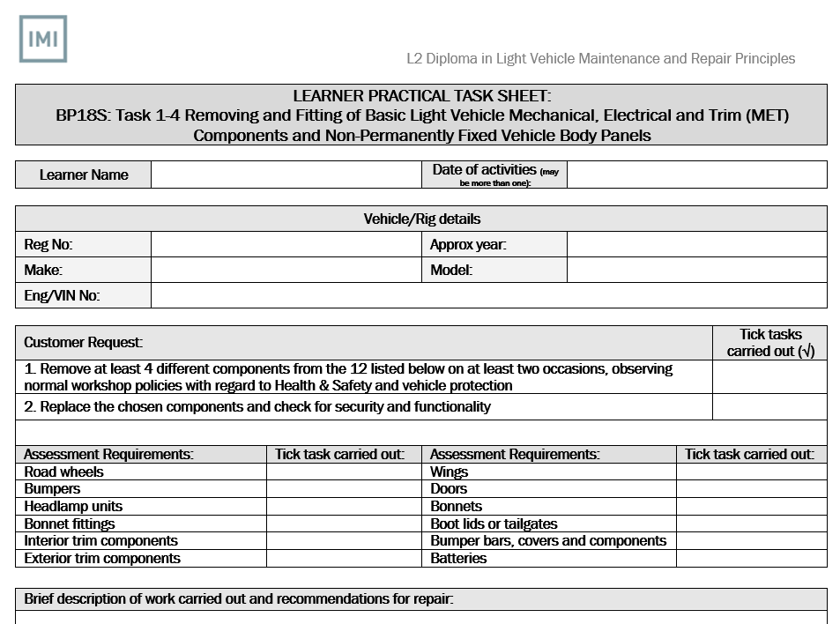
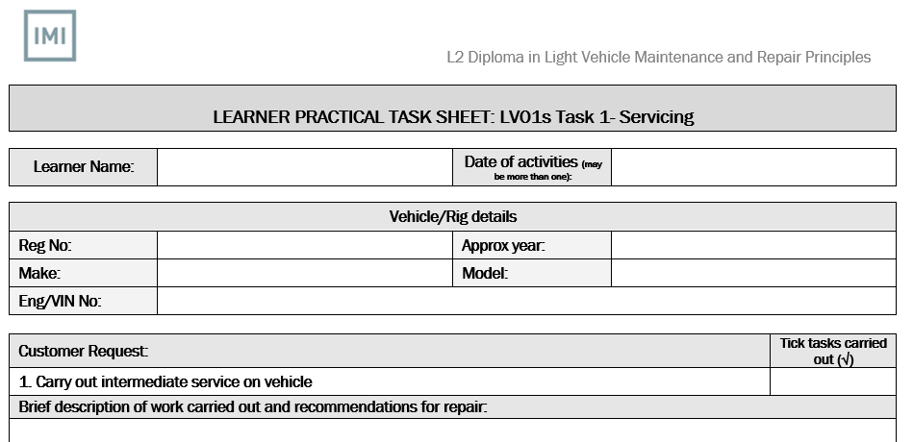
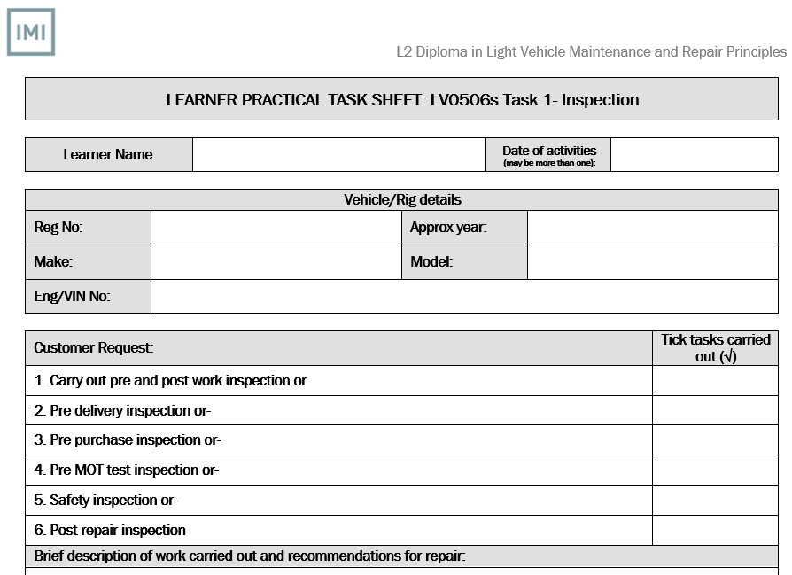
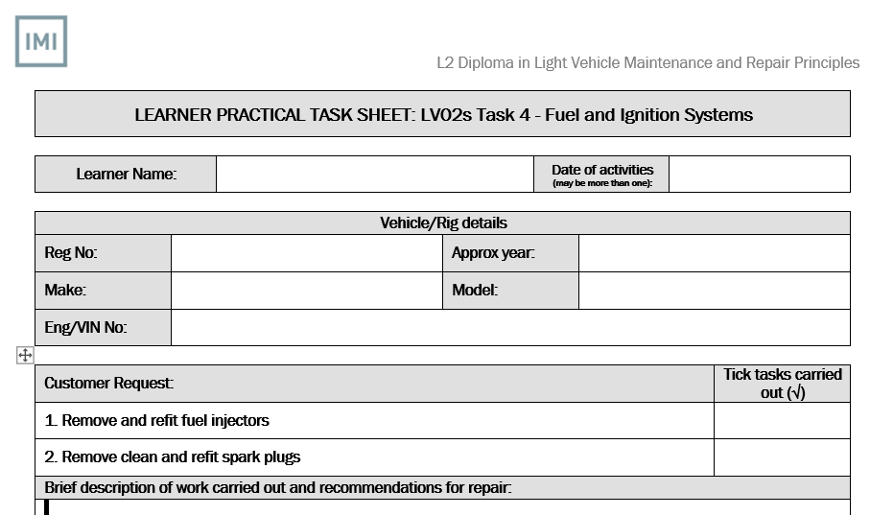
Consolidating Practical Tasks
Holistic approach
Is there anything from one task that fits in with another?
G Units should fit across all tasks
If practise excercises were conducted, keep evidence of these as well.
Notes:
VRQ practical task sheets are available and required for each unit in the specific qual being undertaken.
All learners MUST ensure their write-ups are detailed – showing relevant skill levels, all sections of the form added to /completed.
What has been found is Practical task sheets part complete by learners, lack in detail, not signed, dated, etc.
We advise feedback is added to support growth and reflective learning.
If practice sessions have been made before a final attempt, them keep these as well.
If images are taken, please include narration on the image and an audit trail to where these are stored etc.

Slide 10
Category B
Teacher Assessed Grades (TAG)
Teacher Assessed Grades are allowable for qualifications in category B1 and where it is not possible to complete an assessment for category B2.
We will allow centres to collate and consider a wide variety of evidence to apply a TAG. This evidence must demonstrate that learning has been undertaken to support incomplete units and include an evaluation of performance to date against grading criteria with rationale / commentary to support the TAG submission

Slide 11
Qualifications included in Category B1 (KS4):
QAN | Title
601/0531/8 | IMI Level 1 Certificate in Service and Maintenance Engineering (VRQ) Technical Award
601/0532/X | IMI Level 2 Certificate in Service and Maintenance Engineering (VRQ) Technical Award
601/0542/2 | IMI Level 2 Diploma in Service and Maintenance Engineering (VRQ) Technical Award
603/3088/0 | IMI Level 1 Certificate in Carrying Out Periodic Vehicle Maintenance and Inspection Technical Award
603/3089/2 | IMI Level 2 Certificate in Automotive Maintenance Technical Award

Slide 12
IMI Key Stage 4, Teacher Assessed Grades (TAG) Process
Step 1
Collect candidate evidence to support determination of TAG
Step 2
Centres must consider the quality of evidence presented and suitability for TAG
Step 3
When sufficient evidence has been gathered and evaluated, assessors’ will be asked to make a judgement of each candidates’ performance based on the range of evidence
Step 4
Centres must ensure that TAG’s are subject to robust internal quality assurance. They must also be signed-off by the Head of Centre
Step 5
Centres will be required to submit a sample of evidence for external quality assurance

Slide 13
Category B1 - IMI KS4 TAG evidence overview
Assessments | (TAG) Requirements for submission |  |  | Submission deadline*
 | Teacher Assessed Grade (TAG) | Variety and types of evidence | IQA Sample of evidence
Online Assessment | ✓ | Written knowledge assessments for proxy request | ✓ | 30th June 2021
Synoptic Assignment | ✓ | Teacher judgement of how the candidate would have completed | ✓
Centre Assessed Components | ✓ | Practical and written assessments | ✓
Employer Involvement | Relaxed by the DFE
Evidential Threshold
Will be determined based on the evidence provided, in that it clearly demonstrates that sufficient learning has taken place to meet the critical components of the units.
Unless there is sufficient evidence that the key learning outcomes have been covered, it may not be possible to award as this will undermine the validity of the qualification.

Slide 14
Category B1 - IMI KS4 TAG evidence overview
Unit component assessment type | Evidence
Practical | Holistic approach from other units – have other units been completed? If so these can be provided as evidence to support TAG Other supporting evidence: professional discussions to support incomplete areas previously completed tasks/practice tasks Informal assessments tracking sheets coursework/homework evidence of remote learning/eLearning formative assessments video evidence previously authorised/agreed CAG under ERF
Online assessment | Written assignment can be used as evidence to support a TAG
Written | Could be met through evidence of the achievement of completing the online assessment, coursework or knowledge from additional units - teacher can judge the appropriate grade as part of TAG submission
Synoptic | Professional discussion to support incomplete areas or evaluation of performance to-date against grading criteria with rationale/commentary to support TAG
Pass – 60-74% Merit – 75-84% Distinction – 85%+

Slide 15
Qualifications included in Category B2
QAN | Title
501/0953/4 | IMI Entry Level Award in Personal and Social Development for the Automotive Environment (VRQ)
501/0962/5 | IMI Level 1 Award in Personal and Social Development for the Automotive Environment (VRQ)
601/8195/3 | IMI Entry Level Award for the Introduction to Motor Vehicle Industry and Technologies (VRQ)
601/8196/5 | IMI Entry Level Certificate for the Introduction to Motor Vehicle Industry and Technologies (VRQ)
601/8197/7 | IMI Entry Level Diploma for the Introduction to Motor Vehicle Industry and Technologies (VRQ)
601/8753/0 | IMI Level 1 Award in Transport Maintenance
601/8754/2 | IMI Level 1 Certificate in Transport Maintenance
601/8755/4 | IMI Level 1 Certificate in Vehicle Valeting
601/8756/6 | IMI Level 1 Diploma in Transport Maintenance
601/8871/6 | IMI Level 1 Diploma in Vehicle Accident Repair
601/8872/8 | IMI Level 1 Certificate in Vehicle Accident Repair
601/8873/X | IMI Level 1 Certificate in SMART Repair
601/8874/1 | IMI Level 1 Award in Vehicle Accident Repair
603/2245/7 | IMI Level 1 Award in Cycle Maintenance

Slide 16
What evidence can be used to determine a TAG for B2
The variety and types of evidence that can be used could include:
previously completed tasks/practice tasks tracking sheets / attendance records coursework evidence of remote learning/eLearning professional discussions to support incomplete areas formative assessments video evidence written knowledge assessment for proxy request
Evidential Threshold
The minimum evidential threshold will be determined, based on the evidence provided (see evidence list above), in that it clearly demonstrates that sufficient learning has taken place to meet the critical components of the units.
Unless there is sufficient evidence that the key learning outcomes have been covered, it may not be possible to award as this will undermine the validity of the qualification.

Slide 17
Inflight learners
Learners on year 1 of a 2-year programme – 2020 start year
Learners are eligible for a teacher assessed grade for any assessment completed in their first year. This may be banked towards future completion via a unit claim
Learners in year 2 of a 2-year programme
Existing banked results (including those received through a Centre assessed grade (CAG) in summer 2020) can be used to certificate in 2020–21. This means that banked outcomes from external assessments can be combined with existing, or yet to be submitted results from internal assessments, including those arrived at through a teacher assessed grade
Note
Learners who wish to improve on a TAG result through not undertaking an exam, could be given an opportunity to improve their grade via the online assessment, in the Autumn term. Centre to arrange.

Slide 18
TAG - Internal Quality Assurance requirements
Internal quality assurance within the centre will be vital to supporting the validity of the process. Centres will need to start considering what learners have completed within their qualifications and what is missing.
The Centre must take all reasonable steps to ensure that the arrangements that are in place in relation to robust internal quality assurance include –
(a) a clear approach to making judgements in relation to each Teacher Assessed Grade, including how evidence will be used, and
(b) a high-level cross-check of the Teacher Assessed Grades against results for previous cohorts at the Centre who took assessments for the same qualification in previous years to provide an indication that Teacher Assessed Grades overall are not overly lenient or harsh by comparison with those results from previous years.

Slide 19
TAG - Internal Quality Assurance requirements
In particular, a Centre must take all reasonable steps to ensure that the Teacher Assessed Grade has been reviewed by both –
(a) subject Teachers or Assessors, and
(b) the relevant head of department or equivalent or, where there is no person in such a role, the head of Centre or a person of authority.
Whereas data from previous years can potentially provide a useful high-level cross-check on overall grading patterns to ensure that objectivity is being maintained, each Learner's Teacher Assessed Grade should be determined by the specific performance of that student in relation to the relevant qualification.

Slide 20
TAG - Internal Quality Assurance Strategy
Centres must revise their IQA strategy to include:
Coverage of content and assessment objectives
Authenticity- how confident is the teacher that it is the candidates own work? Where this includes group work, the teacher must be confident about the candidate’s own contribution
Marking – how much support was available to help you in applying the marking scheme?
What internal standardisation processes have been applied
When and how the evidence was produced e.g. remote learning, practiced tasks or teachers judgement of performance
A fair reflection of the candidates performance over a period of time. If you think a candidate could do better, consider what other evidence might present a fairer reflection of the attainment to support a higher teacher assessed grade.

Slide 21
TAG Submissions – Process / Timeline
Who
When
Deadline for submissions - 30th June 2021
How
IMI claim spreadsheet available from your EQA
Centre to determine approach for eligible TAG qualifications
What
Complete IMI claim submission spreadsheet
Complete relevant KS4 grading sheet (for category B1)
Sign Head of Centre declaration
Submit supporting evidence / judgements for incomplete units
Centre to collate appropriate evidence / judgements for incomplete units
Centre undertakes Internal Quality Assurance for proposed TAG submissions
Grading sheets available from qualification pages on the IMI Awarding website
Upload spreadsheets and supporting evidence into Centres Hub documents section - notifying your EQA
External Quality Assurance team will aim to complete submissions within 30 working days of recepit
Centres will be notified if submissions will exceed this timescale

Slide 22
Improved Learner Tracking (Lessons Learnt from ERF)
The need for improved tracking is evident, for individual's achievement as well as group achievement.
What's been done, what is still needed?
A tracker supports this, and could include:
All units, task attempts, actual tasks, assessment types, start & end dates, withdrawals, new and late starters.
Look for common units and themes when planning which will aid the holistic approach
Can you change the option unit to support the learner?
Is the rule of combination being met, are you doing too much?
See candidate assessment summaries to support

Slide 23
Formative IQA (Lessons Learnt from ERF)
Increased ‘in-progress’ sampling conducted. Supports TAG
SOW reviewed and align sampling.
Connection between Assessor & IQA increased.
Detailed and factual IQA reports.
Supportive feedback to Assessors.
Closed off reporting – SMART time lines for completion.
Recording & Signing off completed units.
Processes are being followed when claims are made.
Summative IQA only identifies issues at the end, then its too late!

Slide 24
Useful IMI links
https://awarding.theimi.org.uk
https://www.theimi.org.uk/landing/covid-19/news.php
https://webportal.theimi.org.uk
https://awarding.theimi.org.uk/Centres
https://tide.theimi.org.uk/industry-latest/news/home-schooling-weve-got-you-covered
https://tide.theimi.org.uk/industry-latest/events
Assessment arrangements for 2021

Slide 26
Thank you for watching this webinar and for your continued support of the IMI

Slide 27
Thank you for joining us
Watch out for the newsletters
Keep your eye on the web site

